Slide 1
19Z601- MACHINE LEARNING
UNIT- 3
NEURAL NETWORKS AND DECISION TREES : Feed-forward Networks - Network Training - Delta Rule- Gradient Descent – Error Backpropagation - Regularization in Neural Networks - Generalisation - Decision Tree Learning- Representation - Inductive Bias- Issues (9)
Presented by
Ms.Anisha.C.D
Assistant Professor
CSE

Slide 2
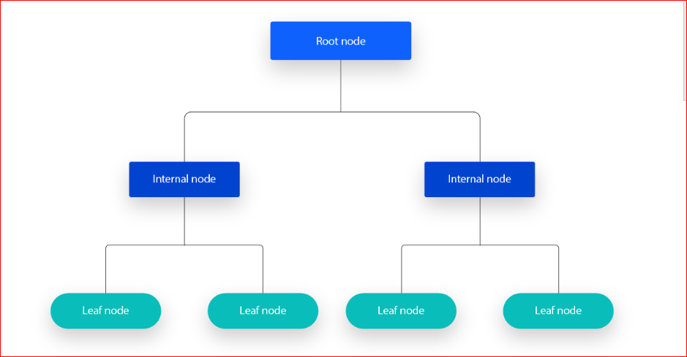
DECISION TREES
A decision tree is a non-parametric supervised learning algorithm, which is utilized for both classification and regression tasks. It has a hierarchical, tree structure, which consists of a root node, branches, internal nodes and leaf nodes.
Source :
https://www.ibm.com/think/topics/decision-trees

Slide 3
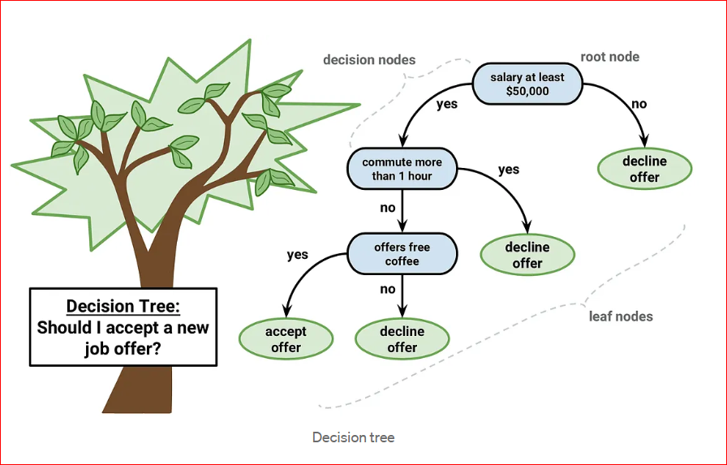
DECISION TREES - EXAMPLE
Source :
https://blog.gopenai.com/decision-trees-a-deep-dive-into-making-smarter-decisions-b0be706513af

Slide 4
DECISION TREE - WORKING
Decision tree learning employs a divide and conquer strategy by conducting a greedy search to identify the optimal split points within a tree.
This process of splitting is then repeated in a top-down, recursive manner until all, or the majority of records have been classified under specific class labels.

Slide 5
DECISION TREE – WORKING (Contd..)
Whether or not all data points are classified as homogenous sets is largely dependent on the complexity of the decision tree.
Smaller trees are more easily able to attain pure leaf nodes—i.e. data points in a single class.
As a tree grows in size, it becomes increasingly difficult to maintain this purity, and it usually results in too little data falling within a given subtree.
When this occurs, it is known as data fragmentation, and it can often lead to overfitting.

Slide 6
DECISION TREE – WORKING (Contd..)
Decision trees have preference for small trees, which is consistent with the principle of parsimony in Occam’s Razor; that is, “entities should not be multiplied beyond necessity.”
Decision trees should add complexity only if necessary, as the simplest explanation is often the best.
To reduce complexity and prevent overfitting, pruning is usually employed; this is a process, which removes branches that split on features with low importance.
The model’s fit can then be evaluated through the process of cross-validation.

Slide 7
Ross Quinlan is credited within the development of ID3, which is shorthand for “Iterative Dichotomiser 3.”
ID3
This algorithm leverages entropy and information gain as metrics to evaluate candidate splits
This algorithm is considered a later iteration of ID3, which was also developed by Quinlan
Types of Decision Tree
C4.5
It can use information gain or gain ratios to evaluate split points within the decision trees.
The term, CART, is an abbreviation for “classification and regression trees” and was introduced by Leo Breiman.
CART
This algorithm typically utilizes Gini impurity to identify the ideal attribute to split on. Gini impurity measures how often a randomly chosen attribute is misclassified.

Slide 8
DECISION TREE – INTUITION (ENTROPY, INFORMATION GAIN AND GINI IMPURITY)
Which Feature should be chosen as root node ?
(Entropy , Information Gain, Gini Impurity can be used to find the optimal root node)

Slide 9
DECISION TREE – INTUITION (ENTROPY, INFORMATION GAIN AND GINI IMPURITY)
Degree | Exp in Years | Placed/Not Placed
Masters | 2 | Placed
Bachelors | 0 | Not Placed
Masters | 3 | Placed
Masters | 1 | Not Placed
Bachelors | 2 | Placed
Masters | 3 | Placed
Bachelors | 0 | Not Placed
Bachelors | 1 | Not Placed

Slide 10
DECISION TREE – INTUITION (ENTROPY, INFORMATION GAIN AND GINI IMPURITY) EXAMPLE
Choose Degree as Root Node
Choose Experience as Root Node
Degree
Experience > 2 years
Masters
Bachelors
Yes
Experience > 2 years
No
Experience < 2 years
Masters
Bachelors
Placed
Not Placed
Placed
Not Placed
Placed
Placed
Placed
Not Placed
Placed
Placed
Not Placed
Placed
Not Placed
Not Placed
2:2
3:1
2:0
1:3
Entropy : High
Information Gain : Low
Gini Impurity : High
Entropy : Low
Information Gain : High
Gini Impurity : Low

